Slide 1
2019 MMILAB.DIP Seminar Week4(1/30~2/5)
20151415 김성수

Slide 2
Contents
4,8 connected component labeling(CCL)
Union find algorithm
Coloring
Effective way and Meaningful result
Questions

Slide 3
Focus of this week
Comparison between algorithm
How to enhance performance??

Slide 4
4-CCL
I(i-1,j-1) | I(i-1,j) | I(i-1,j+1)
I(i,j-1) | I(i,,j) | I(i,j+1)
I(i+1,j-1) | I(i+1,j) | I(i+1,j+1)
If I(i-1,j) and I(i,j-1) are both connected,
: choose one of them (min value is better)
Append I(i-1,j) and I(i,j-1) on list, to decide representative label afterward

Slide 5
8-CCL
I(i-1,j-1) | I(i-1,j) | I(i-1,j+1)
I(i,j-1) | I(i,,j) | I(i,j+1)
I(i+1,j-1) | I(i+1,j) | I(i+1,j+1)
When more than two pixels are connected,
: choose one of them (min value is better)
Append connected components on list, to decide representative label afterward

Slide 6
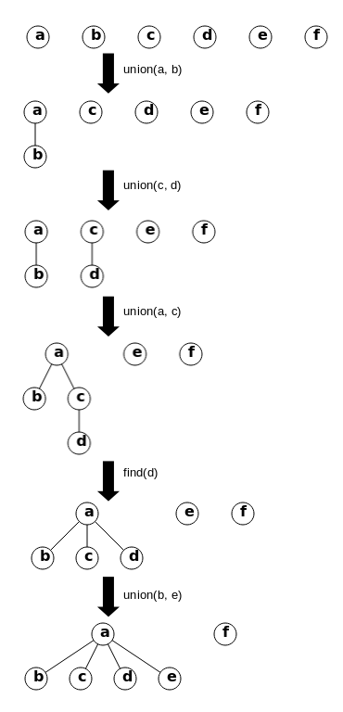
Union find
Root

Slide 7
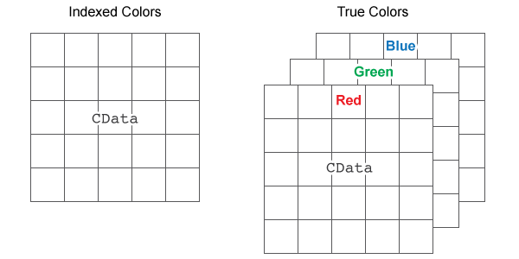
Coloring
After label resolving
1. Sort label value (ex: [1,3,19,29….])
2. Divide each Label value’s index by constant value
and get remainder
( ex: constant =5, [0,1,2,3,4,5,0,1,2…] )
Assign different color for each pixel’s remainder
Convert gray image to color image
1. make three image size of zero array ( for 3 color channel, initialize)
2. Stack 3 zero array
3. Assign color (R,G,B) value to each array for each case

Slide 8
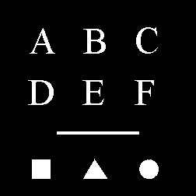
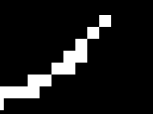
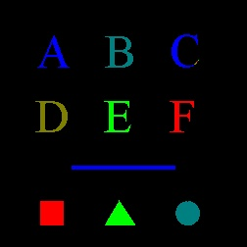
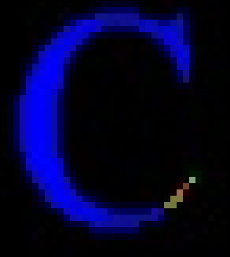
Difference between 4-CCL 8-CCL

Slide 9
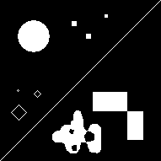
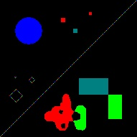
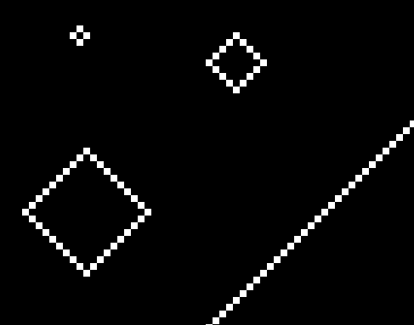
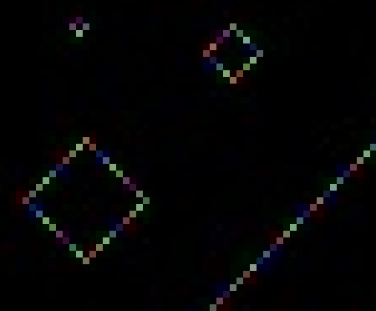
Difference between 4-CCL 8-CCL

Slide 10
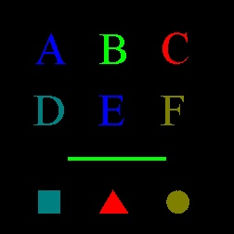
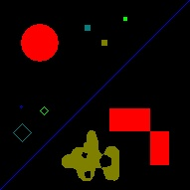
Difference between 4-CCL 8-CCL

Slide 11
Connected component pixel counting
Pixel counting
A : Label =3, 260 pixels
B : Label =5, 400 pixels
C : Label =8, 251 pixels
D : Label =15, 396 pixels
E : Label = 20, 301 pixels
F : Label = 19, 260 pixels
ㅡ : Label = 27, 424 pixels
□ : Label = 29, 408 pixels
△ : Label = 28, 600 pixels
○ : Label = 31, 490 pixels

Slide 12
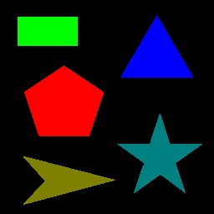
Connected component pixel counting
Pixel counting
□ : Label = 2, 2520 pixels
△ : Label = 1, 3298 pixels
pentagon : Label = 3, 5636 pixels
▷: Label = 21, 2532 pixels
☆: Label = 19, 3240 pixels

Slide 13
Effective way (for 8CCL)
1. Reducing operation (resolve, zero pixel)
2. Reducing conditional(=if) , loop iteration(=for)
How to efficiently access to image pixel?
3. Memory access
4. Union find

Slide 14
Reducing operation(resolve)
I(i-1,j-1) | I(i-1,j) | I(i-1,j+1)
I(i,j-1) | I(i,j)
1. No min() operation
2. Reducing resolve operation

Slide 15
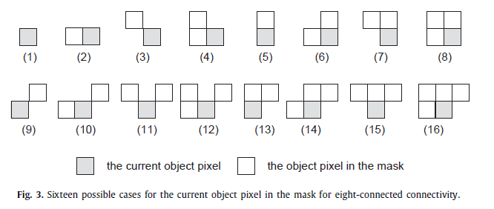
Reducing operation(resolve)
Fast connected-component labeling
L He, Y chao, K Suzuki, K wu – Pattern recognition,2009- Elsevier
C2 | C3 | C4
C1 | I(i,j)
The condition under which resolve does not take place
: C3 +/C4 +/C1*/C2

Slide 16
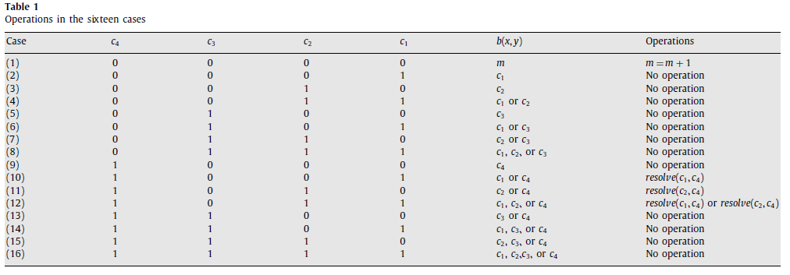
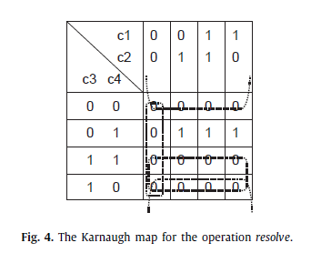
Reducing operation(resolve)
Fast connected-component labeling
L He, Y chao, K Suzuki, K wu – Pattern recognition,2009- Elsevier
The condition under which resolve does not take place
: C3 +/C4 +/C1*/C2

Slide 17
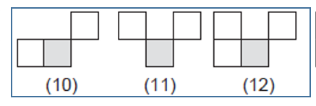
Reducing operation(resolve)
Fast connected-component labeling
L He, Y chao, K Suzuki, K wu – Pattern recognition,2009- Elsevier
Addtionally : if C1==C4, C2 ==C4 , no operation

Slide 18
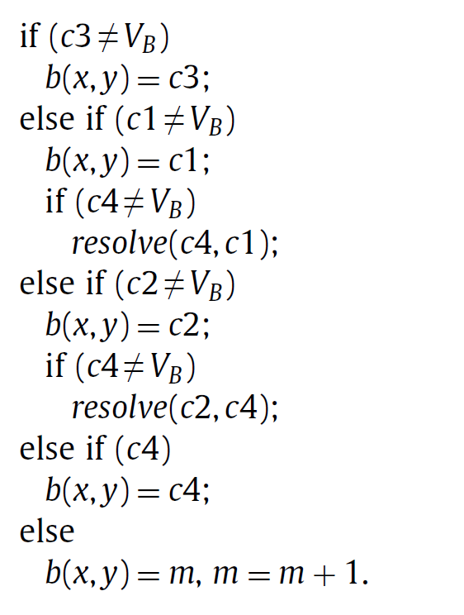
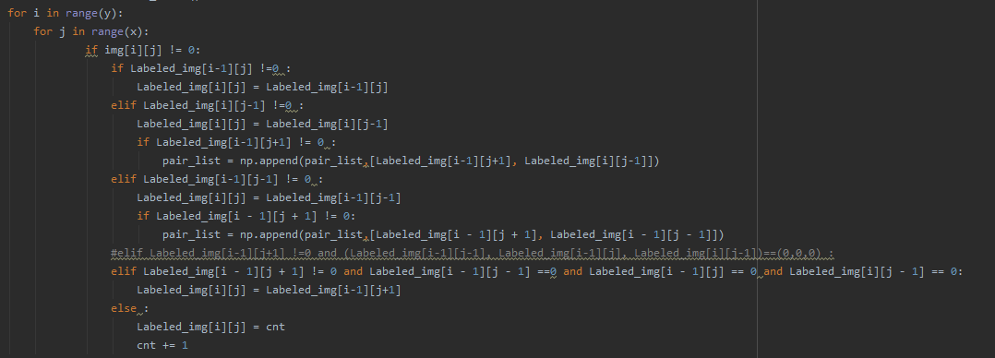
Reducing operation(resolve)
Fast connected-component labeling
L He, Y chao, K Suzuki, K wu – Pattern recognition,2009- Elsevier

Slide 19
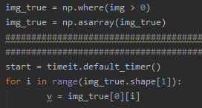
Reducing operation(zero pixel)
Don’t need to operate for zero pixel
-After initializing, no access for zero pixel
I(i-1,j-1) | I(i-1,j) | I(i-1,j+1)
I(i,j-1) | I(i,j)
I(i-1,j-1) | I(i-1,j) | I(i-1,j+1)
I(i,j-1) | I(i,j)

Slide 20
Reducing operation( 2d array -> 1d array )
Nested for loop -> one for loop
2d array access -> 1d array access
x
I(i-1,j-1) | I(i-1,j) | I(i-1,j+1)
I(i,j-1) | I(i,j)
I(i-x-1) | I(i-x) | I(i-x+1) | I(i-1) | I(i)
y
flattening -> reshaping
: 2 times faster

Slide 21


Reducing operation( 2d array -> 1d array )
2d array access -> 1d array access
Resolve pair
Pair_list
:[ (3,4),(4,5),(5,6),….]
Resolve pair
Pair_list
:[ 3,4,4,5,5,6,….]

Slide 22
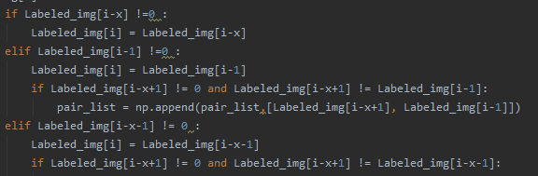
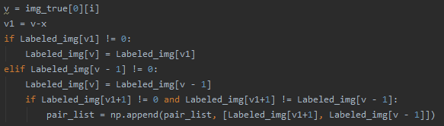
Reducing operation( Index calculation)
Index pre-calculation
-> variable
1.More efficient memory access
2.Reduce summation operation

Slide 23
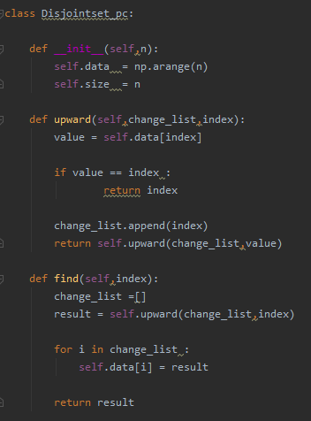
Reducing operation( Union find )
1.Path compression
->Reduce iteration in finding root
2.Disjoint set size = Maximum label value +1
(for optimization)
Pair_list
:[ 3,4,4,5,5,6,….] -> maximum value

Slide 24

Reducing operation( Second pass loop )
Need two kind of loop -> Make Index array and iterate only for unequal component
Need one loop
Disjoint data (After union find)
: [ 0 1 2 3 3 3 3 3 3 3 3 3 3 3 3 3 3 4 5 5 5 7 7]
Index array
: [ 0 1 2 3 4 5 6 7 8 9 10 11 12 13 14 15 16 17 18 19 20]

Slide 25
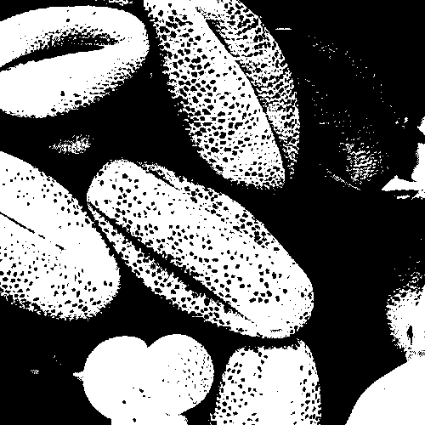
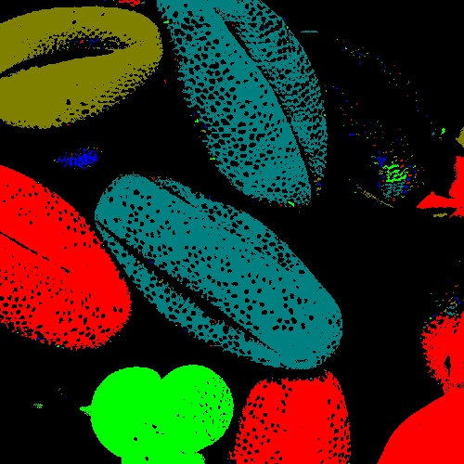
Conclusion(pollen.bmp)

Slide 26
Conclusion(pollen.bmp)
unit : s | No optimization | Resolve reduction | zero-pixel reduction | Array Dimension reduction | pass Compression (union find) | Second-pass reduction | Index pre-calculation
First – pass | 35.4 | 3.25 | 1.63 | 0.80 | 0.80 | 0.80 | 0.65
Union-find | 0.2 | 0.03 | 0.03 | 0.025 | 0.0126 | 0.0126 | 0.0126
Second-pass | 1.2 | 1.2 | 1.2 | 0.54 | 0.54 | 0.28 | 0.28
Coloring | 1.23 | 1.23 | 0.789 | 0.158 | 0.158 | 0.158 | 0.158
Total | 38.03 | 5.71 | 3.649 | 1.523 | 1.5106 | 1.2506 | 1.1006
Total (except coloring) | 36.8 | 4.48 | 2.86 | 1.365 | 1.3526 | 1.0926 | 0.9426

Slide 27
Other image (Symbol)

Slide 28

Other image (polygon)

Slide 29
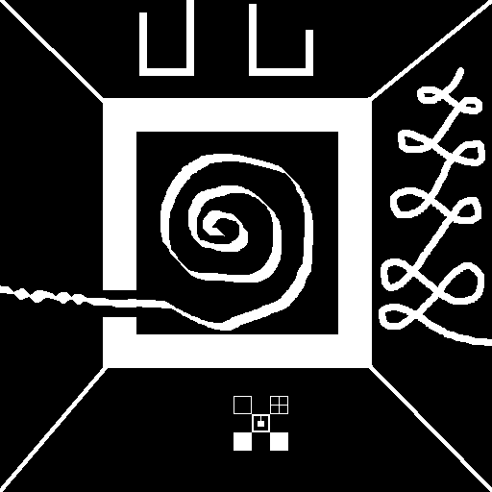
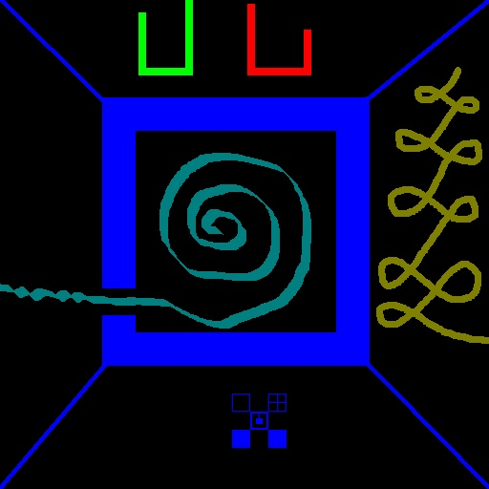
Other image

Slide 30
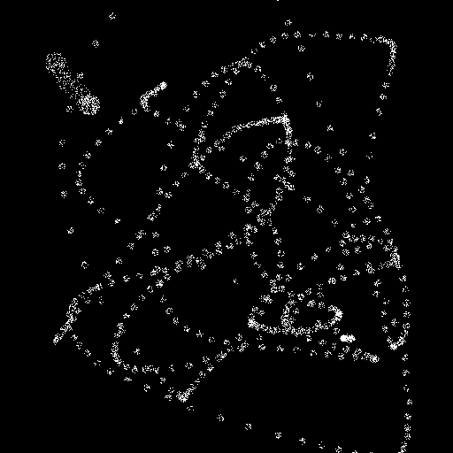
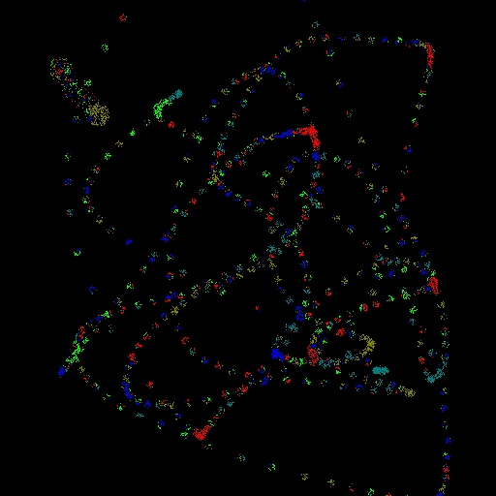
Other image(Foot print)

Slide 31
Other image(Moon light)

Slide 32


Other image(check board)

Slide 33


Other image (white image)

Slide 34
Other image
unit : s | Symbol | Polygon | Haze | Foot print | Moonlight | Check-board | White image
First – pass | 0.0403 | 0.1208 | 0.3419 | 0.1209 | 0.0255 | 2.4197 | 1.6127
Union-find | 0.0008 | 0.0006 | 0.0014 | 0.0081 | 0.0003 | 0.1816 | 0.0002
Second-pass | 0.0041 | 0.0026 | 0.0555 | 0.1776 | 0.0008 | 0.0495 | 4.478 e-05
Coloring | 0.0055 | 0.0071 | 0.0184 | 0.6893 | 0.0031 | 0.0175 | 0.020
Total | 0.0507 | 0.1311 | 0.4172 | 0.9959 | 0.0297 | 2.6683 | 1.6329
Total (except coloring) | 0.0452 | 0.124 | 0.3988 | 0.3066 | 0.0266 | 2.6508 | 1.6129

Slide 35
QUESTION
Any possible order exist for CCL?
I(i-1,j-1) | I(i-1,j) | I(i-1,j+1)
I(i,j-1) | I(i,,j) | I(i,j+1)
I(i+1,j-1) | I(i+1,j) | I(i+1,j+1)
2. Flatten is faster , why?

Slide 36
THANK YOU for your attention

